Slide 1

HUM111 Pakistan Studies
Lecture 06

Slide 2
HUM 111 Pakistan Studies
Lecture 06
Khilafat Movement, Nehru Report and Jinnah’s 14 Points
Dr. Sohail Ahmad

Slide 3

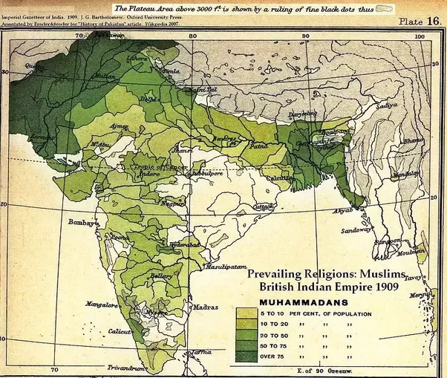
Demographic Map of India 1/2

Slide 4
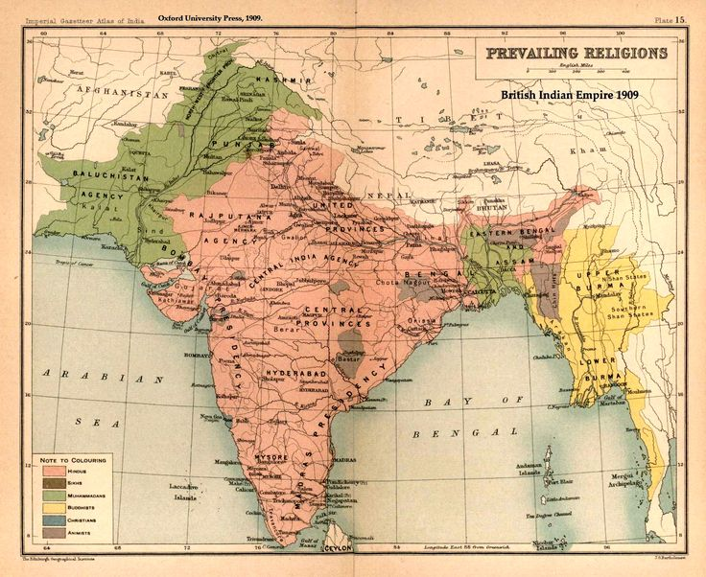
Demographic Map of India 2/2

Slide 5
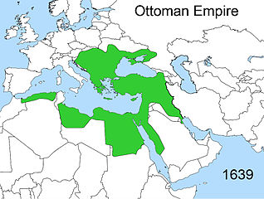
Ottoman Empire 1/3

Slide 6
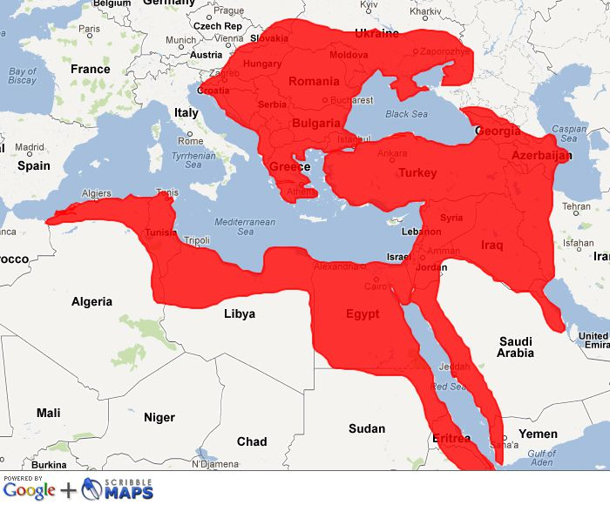
Ottoman Empire 2/3

Slide 7
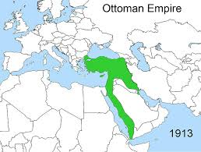
Ottoman Empire 3/3

Slide 8
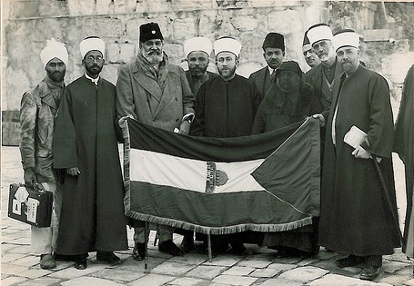
Khilafat Movement [1/7]
The Khilafat movement (1919-1924) was an agitation by Indian Muslims allied with Indian nationalism in the years following World War I. Its purpose was to pressurize the British government to preserve the authority of the Ottoman Sultan as Caliph of Islam following the breakup of the Ottoman Empire at the end of the war.

Slide 9
Khilafat Movement [2/7]
The Khilafat movement was a very important event in the political history of India.
The Muslims of India had a great regard for the Khilafat (Caliphate) which was held by the Ottoman Empire.
During World War I, the Ottoman Empire (Turkey) joined the war in favor of Germany.
But Turkey and Germany lost the war and a pact commonly known as Istanbul Accord was concluded between the Allied Forces on 3rdNovember 1918.
According to this Pact the territories of Turkey were to be divided among France, Greece and Britain.

Slide 10
Khilafat Movement [3/7]
During the war the Indian Muslims were in a very awkward position, because they had a deep-rooted devotion to the caliphate.
They had profound respect for this holy institution. Therefore, their support to the British Government was subject to the safeguard and protection of the holy places of Turkey and on the condition that Turkey will not to be deprived of its territories.
The British Government could not fulfill both of these promises.
The Treaty of Savers 1920 was imposed on Turkey and its territories like Samarna, Thrace and Anatolia were wrested from it and distributed among European countries.
A wave of anger swept across the Muslin World and the Indian Muslims rose against the British Government.
Muslim leaders like Maulana Abdul Kalam Azad, Moulana Muhammad Ali Johar, Moulana Shoukat Ali and others reacted against the British Government policy and were put behind the bars.

Slide 11
Khilafat Movement [4/7]
Muslims organized a mass movement, which came to be known as Khilafat Movement. The aims of this movement were
To protect the Holy place of Turkey
To restore the Territories of Turkey
To restore the Ottoman Empire.

Slide 12
Khilafat Movement [5/7]
In December 1919 both the Khilafat Committee and Congress held their meetings simultaneously at Amritsar and a delegation was prepared which was sent to England under the leadership of Maulana Mohammad Ali Johar to see the British Prime Minister, Cabinet Member and Members of Parliament and to explain the Indian point of view regarding the Khilafat.
The delegation visited England in 1920. The leaders of the delegation addressed the House of Commons and saw the British Prime Minister, Lloyd George, who paid no heed to the delegations demand.
The delegation stayed at London for eight months and won many hearts and sympathies of people in Britain by delivering speeches. However, the delegation returned to India unsuccessful in October 1920.

Slide 13
Khilafat Movement [6/7]
They realized that a new strategy needed to be adopted in order to reinvigorate the zest and zeal for freedom among a general populace.
With this aim they decided to launch a movement of Non Co-operation.
The Congress extended its full support to the Khilafat Movement.
The leaders of the two communities met at Amritsar and resolved to launch a country wide agitation under the leadership of Gandhi.
The agitation was against the British government.

Slide 14
Khilafat Movement [7/7]
The Jamiat-ul-Ulama Hind issued a Fatwa of Tark-e-Mawalat. The following points were included in it:
Renunciation of all Government titles.
Boycott of legislature and court.
Withdrawal of student’s from educational institutions.
Resignation from government posts.
General civil disobedience.
As a result of this proclamation of fatwa, hundreds of thousands people returned the titles and stopped sending their children to government schools and colleges. All those highly educated young men who could have rose to high government positions bode farewell to their bright future and accepted ordinary jobs in the private sector. The vacuum created in government offices was joyfully filled in by Hindus, while the Muslim government employees willingly accepted starvation for the sake of the Muslim cause.

Slide 15
Failure of Khilafat Movement [1/2]
The abolition of Khilafat by Kamal Ataturk was a serious blow to Khilafat movement in the sub-continent and he exiled Sultan Abdul Majeed, a helpless Caliph and abolished Khilafat as an institution, due to this all agitational activities came to an end in the Sub-continent.
The Hijrat Movement made the Muslims disillusioned with the Khilafat Movement due to the declaration of India as Darul-Harab. A large number of Muslims migrated from Sindh and N.W.F.P to Afghanistan. The Afghan authorities did not allow them to cross the border. After this tragic event those who had advocated the Hijrat movement come to realize their mistake which resulted in failure of movement.

Slide 16
Failure of Khilafat Movement [2/2]
When Khilafat movement became mature and was reaching its climax. A tragic incident took place in the village of Chora Churi in which the police opened fire on the procession of local resident. The agitated mob in counteraction set the police station on fires. Resultantly, twenty one police constables were burnt alive. Due to this incident the Ali brother and other Muslim leader were arrested and Mr. Gandhi put off the movement. As a consequence the movement lost its intensity.
The Khilafat movement proved that Hindus and Muslims were two different nations as they could not continue the unity and could not live together.
The Khilafat Movement created political consciousness among the Indian Muslims about their separate identity. Which ultimately paved the way for Pakistan movement.

Slide 17
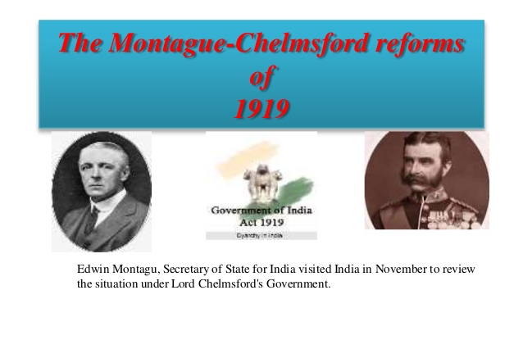
Montague Chelmsford reforms 1919 [1/3]

Slide 18
Montague Chelmsford reforms 1919 [1/3]
Minto-Morley reforms, introduced in 1909, proved unsatisfactory for Indian people.
Indians demanded more representation and called for greater self-government.
This could not be achieved without a formal rapprochement between Congress and Muslim League.
The Lucknow Pact of 1916 asked for self rule

Slide 19
Montague Chelmsford reforms 1919 [2/3]
Meanwhile, the World War I had started and Indians despite their grievances and discontentment with the British joined the war with over one million soldiers with the hope that after the war British would be obliged to concede to selfrule in recognition of their loyal services.
However, as the war dragged on, Indians became disillusioned as the British did not make any promises regarding self government.
Thus Indians pressed for immediate reforms and it was felt that a civil disobedience movement might be launched jointly by congress and Muslim league to compel the British to accelerate the reforms.

Slide 20
Montague Chelmsford reforms 1919 [3/3]
In view of these circumstances the British felt that something must be done to pacify the Indians.
At that time, Edwin Montague was the Secretary of State for India. In his famous August Declaration presented before the House of Commons on 20th August 1917, Montague said that in order to satisfy the local demands, his government was interested in giving more representation to the natives in India.
Lord Chelmsford was sent to India as the new Governor General.
He stayed for six months and held numerous meetings with different government and non-governmental people.
Edwin Montague in collaboration with Lord Chelmsford collected data and made a report about constitutional reforms in 1918.
The report was discussed in the House of Common and later it was approved by the parliament.
The Bill was introduced in India in 1919 and became Act of 1919.

Slide 21
Main Feature of 1919 Act [1/2]
The Council of the Secretary of State was to comprise of eight to twelve people. Three of them should be Indian, and at least half of them should have spent at least ten years in India.
The Central Legislature was to consist of two houses, Upper House (Council of the State), and the Lower House (Legislative Assembly). Council of the State was to consist of 60 members, out of them 35 members would be elected and rest of them would be nominated by the Governor General. The Legislative Assembly was to consist of 144 members, out of them 103 were to be elected and 41 to be nominated by the Governor General. The duration of the Upper House was five and of the Lower House was three years.
Powers were divided between the center and the provinces. The important subjects were vested with the center and unimportant remained with provinces. The important central subjects were defense, foreign affairs, custom, and relations with Indian states, currency and railway. On the contrary, unworthy provincial subjects were local self-government, public health, education etc.

Slide 22
Main Feature of 1919 Act [2/2]
The salary of the Secretary of State for Indian Affairs should be paid from British exchequer; previously, his salary was paid by Indian treasury.
The system of ‘Diarchy’ or a kind of double government in the Provinces was introduced.
Provincial subjects were divided into two categories “Transferred and Reserved.”
Transferred subjects which were public health, education, local self-government, and agriculture were under the control of Minister; likewise all transferred subjects were unimportant.
Reserved subjects included administration, police, land revenue etc. which were under the control of Governor with the help of his secretaries.

Slide 23
Reaction
Congress Reaction
Congress did not participate in the election of 1920 under the 1919 Act
It was against the reforms
In 1923 it decided to participate in elections with a view to destroy the 1919 Act from within
Muslim Reaction
The Muslim League did not reject the act as congress did
Though it was not completely satisfied with the reforms but it initial response was favorable
It too did not participate in the election because of understanding with congress
Thus, some benefits which the Act could yield were reaped by the Hindus alone. It were Muslims who suffered

Slide 24
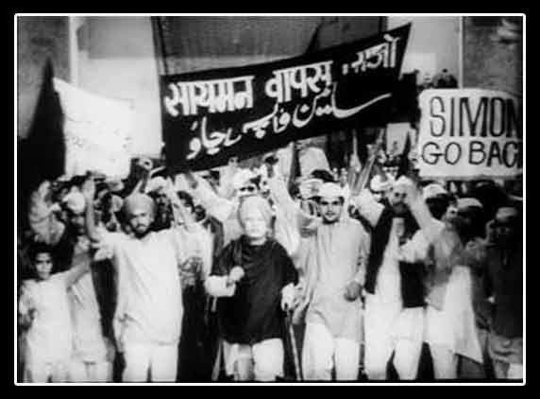
Simmon Commission

Slide 25
Simmon Commission
Simon Commission, group appointed in November 1927 by the British government under Stanley Baldwin to report on the working of the Indian constitution established by the Government of India Act of 1919.
The commission consisted of seven members under the joint chairmanship of the distinguished Liberal lawyer, Sir John Simon, and Clement Attlee, the future prime minister.
Its composition met with a storm of criticism in India because Indians were excluded. The commission was boycotted by the Indian National Congress and most other Indian political parties.
It, nevertheless, published a two-volume report, mainly the work of Simon.
Regarded as a classic state document, the report proposed provincial autonomy in India but rejected parliamentary responsibility at the centre. It accepted the idea of federalism and sought to retain direct contact between the British crown and the Indian states.

Slide 26
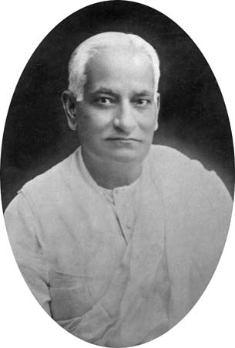
Nehru Report

Slide 27
Nehru Report [1/2]
Most of the Indian political parties decided to boycott the Simon Commission on the plea that it lacked Indian representation.
The British decided to throw the ball in the court of Indian Politicians. Lord Birkendhead, Secretary of State for Indian Affairs, challenged the Indians, “If they have any political capability and competence then they should form a unanimous constitution and present it to us and we will implement it.”

Slide 28
Nehru Report [2/2]
Indian political parties accepted the challenge and called an All Parties Conference at Delhi in January 1928. The conference was attended by around hundred delegates from all the important parties including Indian National Congress, All India Muslim League, National Liberal Federation, Hindu Mahasabha, Central Sikh League etc.
The conference failed to reach a conclusion on the issue of the rights of minorities. The second round of the All Parties Conference was held in March the same year. Two sub-committees were formed but the end result was not different from the first session. It was during the third session of the All Parties Conference held at Bombay in May 1928 that a seven members committee under the chairmanship of Motilal Nehru was formed to determine the basic features of the future constitution of India.
Despite many hurdles, the Nehru Committee completed its task and its report, commonly known as Nehru Report was presented in the fourth session of the All Parties Conference held in August 1928.

Slide 29
Main Features of Nehru Report [1/3]
India should be given Dominion Status with the Parliamentary form of Government. There should be a bi-cameral legislature consisting of senate and House of Representatives. The senate will comprise of two hundred members elected for seven years, while the House of Representatives should consist of five hundred members elected for five years.
Governor-General will act on the advice of executive council. It was to be collectively responsible to the parliament.
There should be Federal form of Government in India with Residuary powers to be vested in Centre.
There will be no separate electorate for minorities. It claimed “since separate electorate awakens communal sentiments therefore it should be scrapped and joint electorate should be introduced”.
System of weightage should not be adopted for any province.
There will be no reserved seats for communities in Punjab and Bengal. However, reservation of Muslim seats could be possible in the provinces where Muslim population should be at least ten percent.

Slide 30
Main Features of Nehru Report [2/3]
Judiciary should be independent from the Executive.
There should be 1/4th Muslim Representation at Centre.
Sind should be separated from Bombay provided it proves to be financially self sufficient.
Reforms should be introduced in NWFP.
The report was not acceptable to Muslims. In the fourth session of the All Parties Conference convened in December to review the Nehru Report, Jinnah representing the Muslim League presented four amendments in the report.

Slide 31
Main Features of Nehru Report [3/3]
The four amendments were:
There should be no less than one-third Muslim representation in the Central Legislature.
In event of the adult suffrage not being established, Punjab and Bengal should have seats reserved for the Muslims on population basis.
The form of the constitution should be Federal with residuary powers vested in the provinces.
Sind should immediately be made a separate province and the reforms should also be introduced in NWFP and Balochistan at the earliest.
Jinnah’s proposals were rejected when put to vote in All Parties Conference. The Congress managed to get the majority vote in favor of the Report. They asked the Government to make a constitution till December 31 according to the recommendations of Nehru Report and threatened that otherwise the party would start a mass movement.

Slide 32
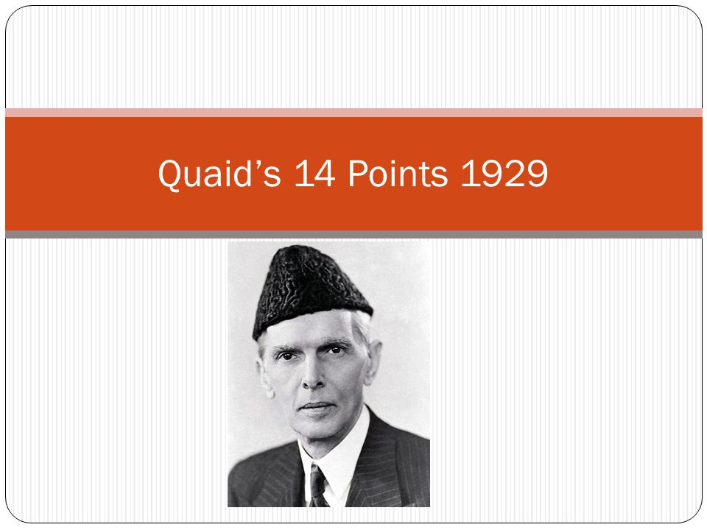
Jinnah’s Fourteen Points

Slide 33
Jinnah’s Fourteen Points [1/3]
In March 1929 ,at the annual session of All India Muslim league, he declared his famous fourteen points.
Federal System: The form of the future constitution should be federal with the residuary powers rested in the provinces.
Provincial Autonomy: A uniform measure of autonomy shall be granted to all provinces.
Representation of Minorities: All legislative in the country and other elected bodies shall be constituted on the definite principles of adequate and effective representation of minorities in every province without reducing the majority in any province to a minority or even equality.
Number of Muslim Representative: In the central legislative, Muslims representative shall be not less than one -third.
Separate Electorates: Representative of communal groups shall continue to be by means of separate electorates as at present provided it shall be open to any community, at any time to abandon its separate electorate in favour of joint electorate.

Slide 34
Jinnah’s Fourteen Points [2/3]
Muslim Majority Provinces: Any territorial re-distribution that might at any time be necessary shall not in any way, effect the Muslim majority in Punjab, Bengal and N.W.F.P.
Religious Liberty: Full religious liberty, liberty of belief, worship and observance, association and education shall be guaranteed to all the communities
Three-Fourth Representation: No bill or resolution shall be passed in any legislative or any other elected body if three-fourths of the members of any community in that particular body oppose such a bill.
Separation of Sind: Sind should be separated from Bombay.
Introduction of Reforms in N.W.F.P and Baluchistan: Reforms should be introduced in the North-West Frontier Province and Baluchistan on the same footing as in other provinces.

Slide 35
Jinnah’s Fourteen Points [3/3]
Government Services: Muslims should be given adequate share along with other Indians in the services of State.
Protection of Muslim's culture and Language: The constitution should embody adequate safeguard for the protection of Muslim culture, language, religion and civilization.
One-Third Muslim Ministers: No cabinet, either central or provincial be formed without being a proportion of at least one-third Muslim Ministers.
Constitution: No change shall be made in the constitution of state except with the concurrence of State constituting the Indian Federation.

Slide 36
Importance of Fourteen Points
A comparison of the Nehru Report with the quaid-e-Azam's Fourteen Points shows that the political gap between the Muslims and the Hindus had really widened. Fourteen points of Quaid-e-Azam became principles for Muslims of India. These points made it clear to Hindus and British Government that Muslims of India are a separate entity. Those points made it clear to Hindus and British Government that Muslims wanted their own identity without influence by Hindus. Fourteen Points not only revived Muslim League but also directed them towards a new way. These points prepared the Muslims of India for a bold step to struggle for freedom.
The importance of these points can be judged by the fact that these points were presented in the Round Table Conference of 1930.
As a result, these points became the demands of the Muslims and greatly influenced the Muslims thinking for the next two decade till the establishment of Pakistan in 1947.

Slide 37
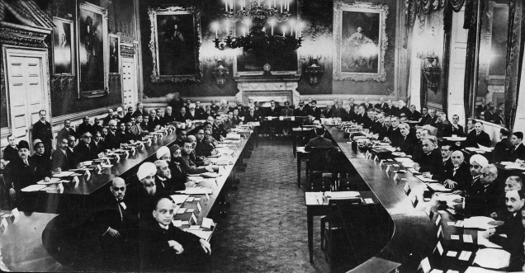
Round Table Conferences

Slide 38
Round Table Conferences
First conference started in November 1930 lasted till January 1931.
Second conference started in September 1931 lasted till December 1931.
Third conference started in November 1932 lasted till December 1932.
Outcome: Unsuccessful to reach a common ground.

Slide 39

1935 Act

